Slide 1

BURSTY EVENT Detection from the Twitter Data
By
Kavita Soni

Slide 2
Motivation
Macroeconomic factors tend to impact wide swaths of populations, rather than just a few select individuals.
The major changes or developments in the macro-events are usually outside the business’ control. It’s essential that the businesses can anticipate the impact of these changes on either the business itself or on its market before they happen.
News channels can inform about these events but there is time gap between the onset of such events and the first new media report.
This gap raises a question of immense practical value: Can we leverage Twitter for automated real-time bursty event detection on a societal scale? YES
With 200 million active users and over 400 million tweets per day as in a recent report, it has been observed that, in life-critical disasters of societal scale, Twitter is the most important and timely source from which people find out and track the breaking news before any mainstream media picks up on them and rebroadcast the footage.

Slide 3
What is Burst Detection ?
Burst detection is a way of identifying periods of time in which some event is unusually popular. In other words, you can use it to identify fads, or “bursts,” of events over time. I liked the idea of using burst detection to identify trends in the twitter data in a data-driven way.
I found the paper that the analysis is based on, titled “Bursty and Hierarchical Structure in Streams”, by Kleinberg (2002). Kleinberg’s burst detection algorithm identifies time periods in which a target event is uncharacteristically frequent, or “bursty.”
You can use burst detection to detect bursts in a continuous stream of events or in discrete batches of events.
My project uses ‘burst_detection’ python package to detect burst of ‘bitcoin’ in twitter data.

Slide 4
Proposed System
Twitter Stream
Stream Listener
Random Real time tweets
Filtered Date
Stop Word
Filter
Bursty Term Detector
Bursty Terms

Slide 5
Project Requirements
Python 3
Python packages : numpy, pandas, seaborn, matplotlib, burst_detection
Jupyter Notebook(Anaconda 3) to run the code file.

Slide 6
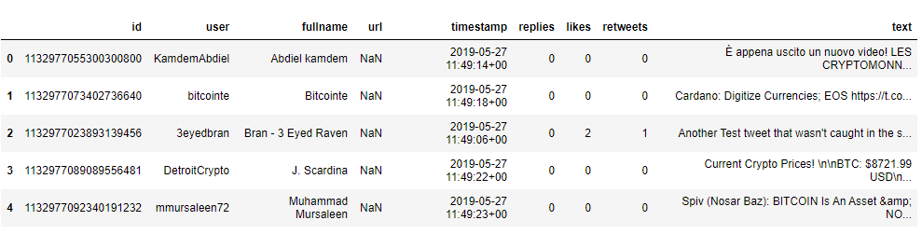
Methodology
For collecting real time tweets, Twitter APIs provide a way for developers to access data about what's happening around the world. Developers can use these APIs to listen for events of interest and build applications that trigger actions based on those events.
The main information required from each tweets is the tweet text and the timestamp. For this project I have taken a dataset of older tweets to detect trend of ‘Bitcoin’. In real time we can batch tweets for a day or a week.

Slide 7
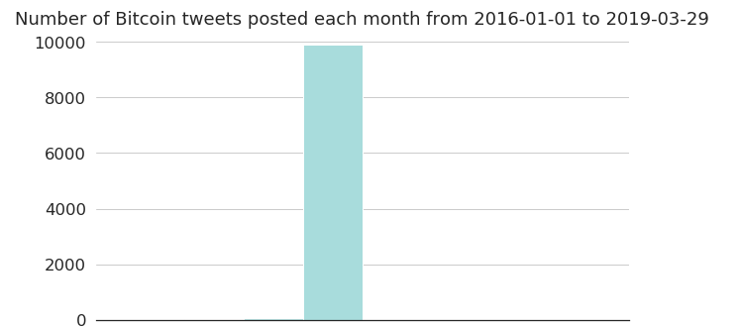
After the important part of tweet is extracted, count all the words in the tweets. Define a count threshold and remove words that appear fewer than X-times. Thus, we get list of unique words with at least X occurrences.

Slide 8
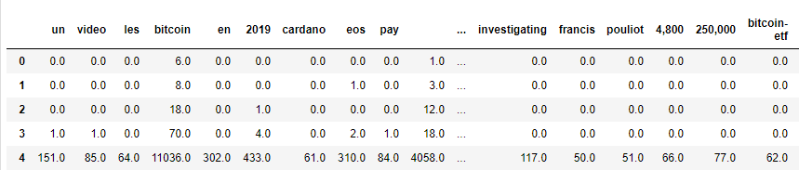
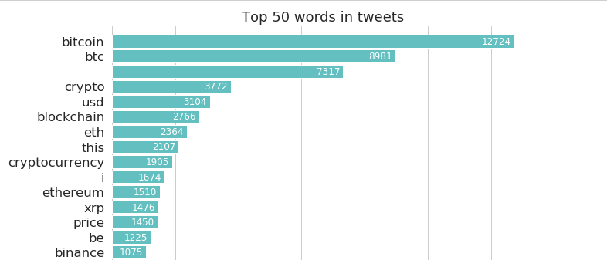
Get the proportions of all unique words across time. Next plot a graph to visualise most common words

Slide 9
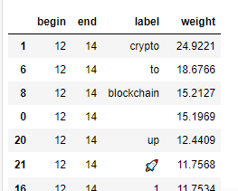
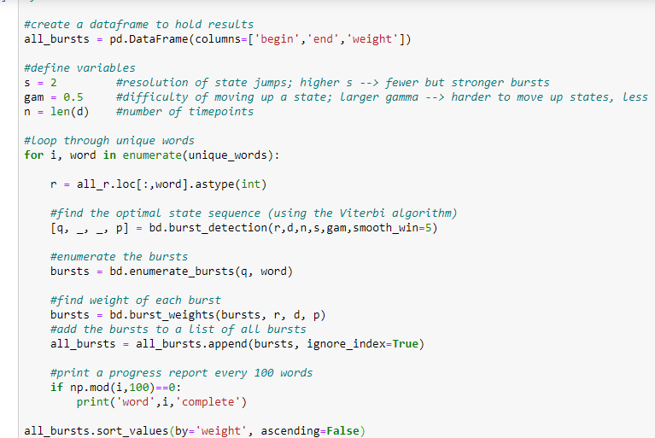
Find burst of each unique word using ‘burst_detection’ module.

Slide 10
Conclusion
It is seen that we can monitor twitter stream data and find burst terms that help us detect trends/ event before they are highlighted by news media.
We can easily detect trends like climate change, political clashes, major government policies, disease outbreak etc.
Based on trend detection we can trigger necessary actions to reduce the ill-effects of macro events on business.
As an improvement this project can be scaled to include a front end interface to show the burst word visualisations.

Slide 11
References
https://pypi.org/project/burst_detection/
http://snap.stanford.edu/class/cs224w-readings/mathioudakis10twitter.pdf (TwitterMonitor: Trend Detection over the Twitter Stream)
https://www.cs.sfu.ca/~wangk/pub/burst.pdf (TopicSketch: Real-time Bursty Topic Detection from Twitter)
https://developer.twitter.com/en/docs/tutorials/listen-for-important-events
https://nikkimarinsek.com/blog/kleinberg-burst-detection-algorithm
https://www.kaggle.com/alaix14/bitcoin-tweets-20160101-to-20190329 (For tweets dataset)

